Slide 1






PYTHON BEGINNER COURSE
2024
2024
PYTHON
BEGINNER COURSE
Lesson 5
SHALEV LAU
/in/shalevl
/mushroomhater07

Slide 2
Functions
Dictionary
Function
Parameter & Argument
Scope
Return
Recursion
VS infinite loop

Slide 3
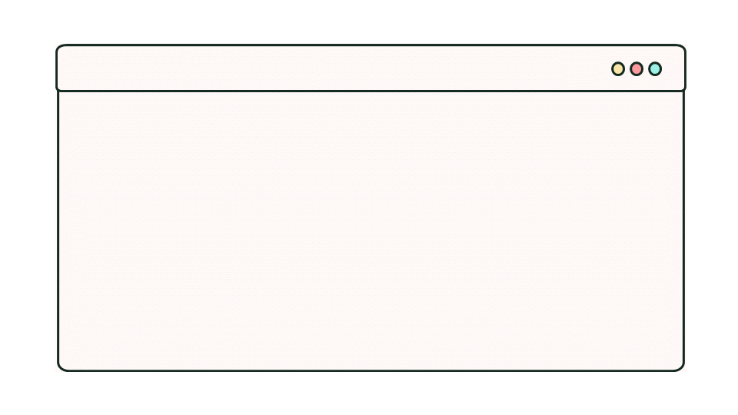


Dictionary
Dictionaries are used to store data values in key:value pairs.
A dictionary is a collection which is ordered, changeable and do not allow duplicates.
Indicate set or dictionary
country_capitals = {
"Germany": "Berlin",
"Canada": "Ottawa",
"England": "London"
}
Different element in the list, separated by ,
Separate key and value by :

Slide 4
country_capitals = {
"Germany": "Berlin",
"Canada": "Ottawa",
"England": "London"
}
country_capitals = {
"Germany": "Berlin",
"Canada": "Ottawa",
"England": "London",
"Italy" : "Rome"
}
country_capitals = {}
country_capitals = {
"Germany": "Berlin",
"England": "London",
"Italy" : "Rome"
}
Dictionary operation
Access
print(country_capitals["Germany"])
Bestplace = country_capitals["England"])
# Berlin
Bestplace = London
Add item
Delete item
Delete all items
country_capitals["Italy"] = "Rome"
del country_capitals["Canada"]
country_capitals.clear()

Slide 5
DT comparsion
Collection data type | Ordered | Allowing duplicates | Changeable | When useful
List | Yes | Yes | Yes | When you care about exact order of elements
Set | No | No | Yes | When you just need to know what elements are in the zoo
Tuple | Yes | Yes | No | When elements are unchangeable
Dictionary | No | Keys - unique Values - may be duplicated | Yes | When you want to store the relations between some elements:
zoo = ["panda", "zebra", "panda", "monkey"]
animals = {"panda", "monkey", "zebra"}
must_have = ("elephant", "zebra", "lion")
no_of_animals = { "panda":2, "zebra":1, "monkey":1 }

Slide 6
What is functions?
print("Hello world!")
len("word")
arr = [1, 2, 3, 4, 5]
sum(arr)
import time
time.sleep(1)
Fun Fact: You’ve already used several functions without even knowing it.

Slide 7
Functions
‘Out of line’ block of code that may be executed (called) by simply writing its name in a program statement.
can be called with or without parameters.

Slide 8


Creating Functions - def
def keyword to define
Make sure:
hello()
: after a statement
4 spacebar in front of a statement
def hello():
name = input("Enter your name")
print('Nice to meet you, ', name)
hello()
Calling statement after define
(only in Python)
() indicate function
AdvantageLocal variable

Slide 9

Parameters
Share variable/ value between function and your main code
Set default parameter
(Not necessary but can be prevenet error)
parameter
Default parameter
def multiply(a, b):
num = a * b
print("Result:", num)
multiply(2, 3)
def multiply(a=2, b=4):
num = a * b
print("Result:", num)
multiply(a=5)
multiply()
argument

Slide 10

Scope - global scope
def random():
num = 5
random()
print(num)
Local scope: variable is available only in one part of the program.
num = 0;
def random():
num = 5
random()
print(num)
Global scope: variable is available within any scope, so can be used anywhere in the program
def random():
global num
num = 5
random()
print(num)

Slide 11

Scope - naming issues
Why not use global at the whole time?
Global scope: variable is available within any scope, so can be used anywhere in the program
num = 0;
def random():
num = 5
def add(add1, add2):
num = add1 + add2
random()
add(5,5)
print(num)
Used up memory
Affect other program/function

Slide 12
Return
def add(num1, num2):
sum = num1 + num2
return sum
result = add(2, 3)
print(result)
def add(num1, num2):
sum = num1 + num2
result = add(2, 3)
print(result)
Another way to pass variable to main program – using return keyword
None
5

Slide 13
Function benefit?
Re-use code: create a common routine once and re-use as many times as you want
Clean code: Make your code structured
Share code with other programs
Independent: Test function separate from the rest of the code
Reduces need for global variables as local variables used instead

Slide 14
Difference
Tuple (datatype)
name = ("John", 15)
name = hello()
name = hello("John", 15)
name = hello(("John", 15))
Function, with no argument
Function, with 2 argument (string & int)
Function, with 1 argument (tuple)

Slide 15
Recursion
A function that called itself (again and again)
def run():
run()
def run(numbers):
run(numbers)
Recursion
Infinite loop
count = 3
def run(numbers):
if(count == 0):
return
else:
return run(numbers - 1)
count = 3
while True:
if(count == 0):
break
else:
count -= 1

Slide 16

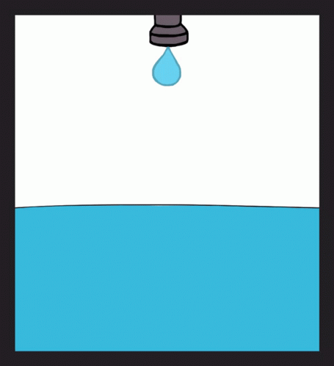


Recursion VS infinite loop
run(), parameter, return, variable
count
count
run(), parameter, return, variable
count
count
run(), parameter, return, variable
count
count
count = 3
def run(numbers):
if(count == 0):
return
else:
return run(numbers - 1)
count = 3
while True:
if(count == 0):
break
else:
count -= 1

Slide 17
Scope - naming issues
A primary school teacher requires a program that will allow pupils to practise their multiplication tables (times tables). The program must allow them to choose the table they want displayed and the start and end numbers to multiply by.
The program will then print a message followed by the table selected.
Create a solution for this using a subroutine called multiples() which takes table, startnum, endnum and pupilName as parameters. The subroutine will output the message and multiplication table. The main program will prompt the user to enter the values and will then pass them to the routine.
What is your name: Joe
Which multiply table? (2-9): 5
Start from(1-15): 4
End at (large than start): 12
Joe, this is your personalised multiplication table
5 x 4 = 20
5 x 5 = 25
…
…
5 x 12 = 60

